Slide 1
Image Dehazing
GROUP - 6

Slide 2
GROUP MEMBERS
ABHIJITH A THAMPI - AM.EN.U4AIE20102
ADITHYAN M NAIR - AM.EN.U4AIE20105
AJAY G NAIR - AM.EN.U4AIE20108
DEVAKRISHNA SANIL KUMAR - AM.EN.U4AIE20119
GOVIND NANDAKUMAR - AM.EN.U4AIE20129

Slide 3
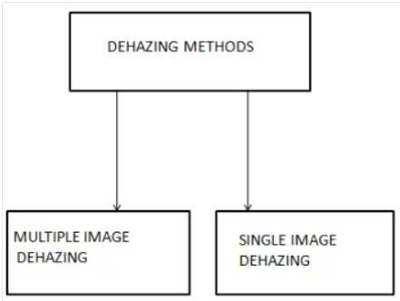
Project Description
Image dehazing is a well-known ill-posed problem, which usually requires some image priors to make the problem well-posed. Single image dehazing aims to estimate a haze-free image from a hazy
image. It is a classical image processing problem, which
has been an active research topic in the vision and
graphics communities within the last decade.
As numerous real-world tasks (e.g., traffic detection and environmental monitoring) require high-quality images, and the hazy environment usually leads to deprecated images, it is of great interest to develop an effective algorithm to recover haze-free images.

Slide 4
DEHAZING
A physical degradation process known as the atmospheric scattering model has been widely applied in many dehaze works. In this manner, the Contextual Regularization based image dehazing is proposed.
A method for recovering a haze-free image given a single photograph as an input.

Slide 5
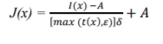
METHODOLOGY
Atmospheric light estimation
IMAGING MODEL AND PROBLEM CONSTRAINTS
I(x) = t(x)J(x) + (1 − t(x))A
Transmission Map Estimation
Scene Radiance Recovery

Slide 6
Atmospheric Light Estimation
We first pick up the top 0.1% brightest pixels in the dark channel, and then select the one with the highest intensity as the estimate of A.
The following method produces a similar result but performs more efficiently.
The method begins with filtering each color channel of an input image by a minimum filter with a moving window.
Then the maximum value of each color channel is taken as the estimate of the component of A.

Slide 7
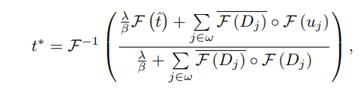
Estimation of Scene Transmission
Dehazing an image requires to estimate an appropriate transmission function t(x) and the global atmospheric light A.
where F(·) is the Fourier transform and F−1(·) is its inverse transform, (·) represents the complex conjugate, and ◦ denotes the element-wise multiplication. The division is also performed in an element-wise manner.λ is the regularization parameter, β is the medium extinction coefficient, uj is the auxiliary variable, Dj is a first-order differential operator

Slide 8
Current Status of the Project
Currently we are working on a dataset of an image with dimensions 640 x 963 pixels. We selected the image from the dataset and produced dehazed versions of the image using Boundary Constraint and Contextual Regularization.

Slide 9
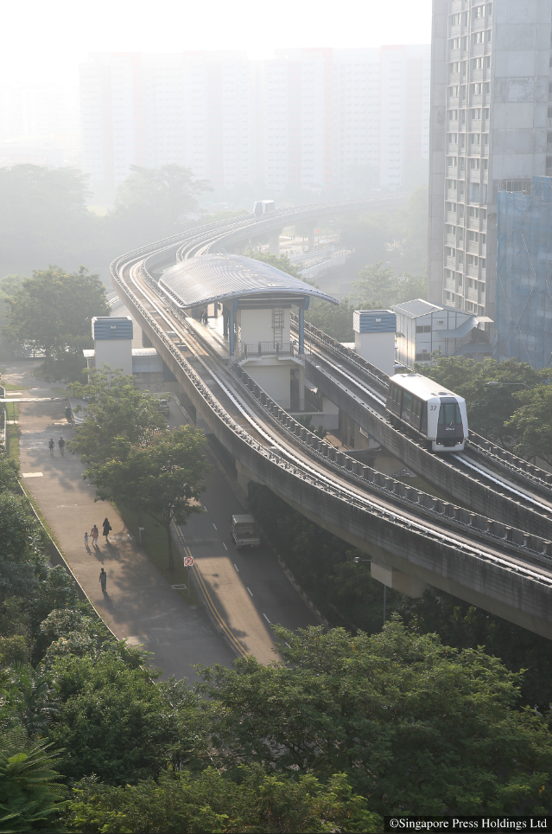
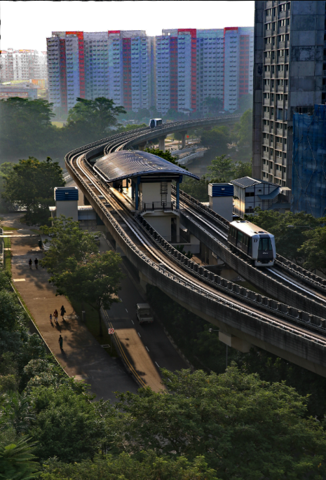
Original Image
Dehazed Image

Slide 10
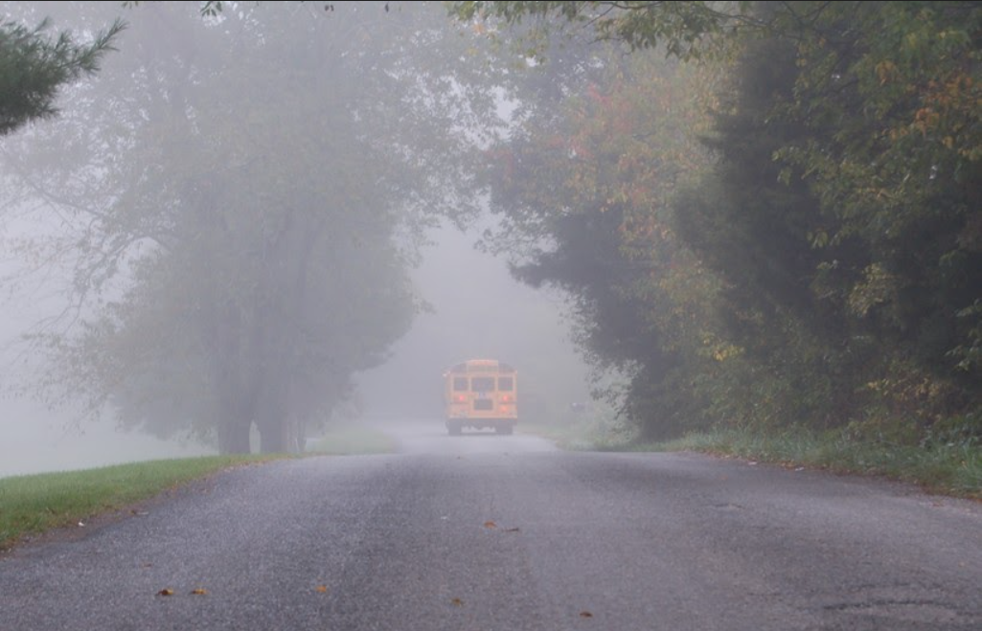
Dataset
The Dataset used for this project consist of images of both jpg and png formats.
Dataset

Slide 11
Base Papers / Demo Code
Paper 1 :
Base paper 1
Paper 2 :
Base paper 2
Github :
GitHubLink
Results Obtained :
ResultsLink

Slide 12
The web-link given below provides the rough work, statistics and information regarding the current status of our project. The dataset are also included.
ImageDehazingReportLink

Slide 13
References
Dana Berman, Tali Treibitz, and Shai Avidan. Non-local Image Dehazing. In CVPR, pages 1628–1636, 2016.
Kaiming He, Jian Sun, and Xiaoou Tang. Single image haze removal using dark channel prior. In CVPR, pages 1956– 1963, 2009..
P. Carr and R. Hartley. Improved single image dehazing using geometry. In Digital Image Computing: Techniques and Applications, pages 103–110, Dec. 2009.
L. Kratz and K. Nishino. Factorizing scene albedo and depth from a single foggy image. In ICCV’09, pages 1701–1708, Oct. 2009
Huiyan Liu, Wenzhang He&Rui Liu, “An improved fog degrading image enhancement algorithm based on Fuzzy contrast“ on 2010 International conference on computational intelligence & security.

Slide 14
Thank You!

